Slide 1
Displaying Data from Multiple Tables
Notes:
Schedule: Timing Topic
55 minutes Lecture
55 minutes Practice
110 minutes Total

Slide 2
Objectives
After completing this lesson, you should be able to
do the following:
Write SELECT statements to access data from more than one table using equality and nonequality joins
View data that generally does not meet a join condition by using outer joins
Join a table to itself by using a self join
Notes:
Lesson Aim
This lesson covers how to obtain data from more than one table.

Slide 3
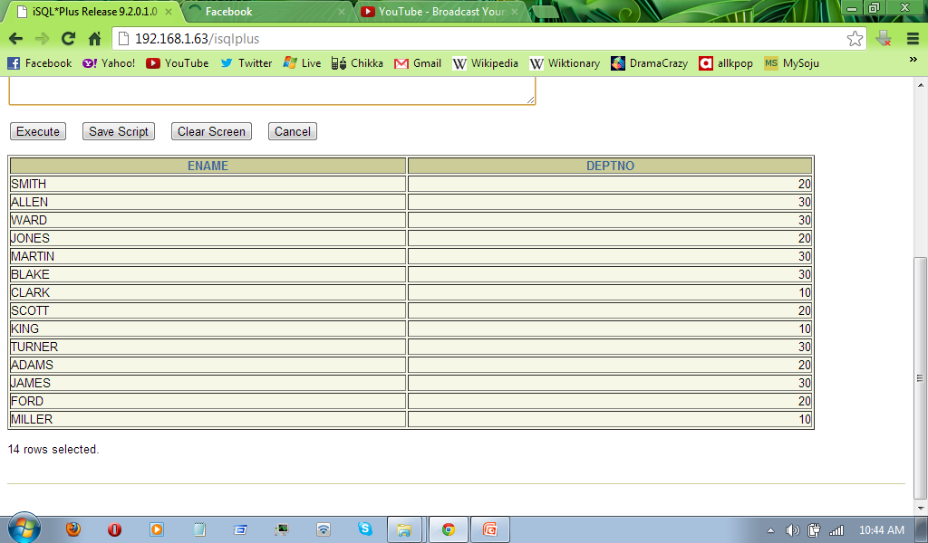
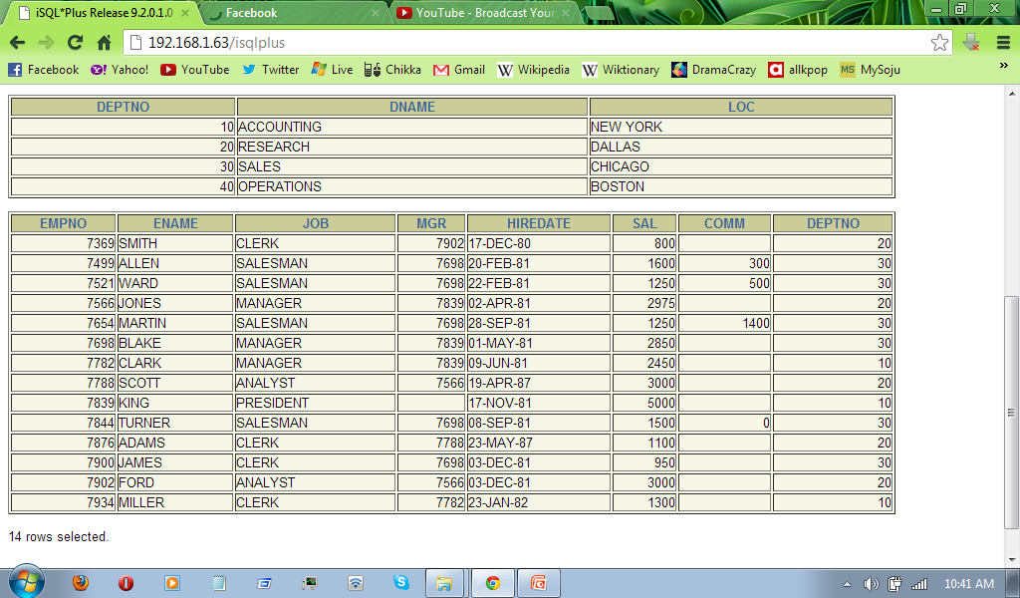
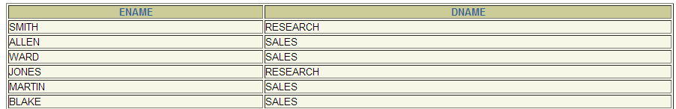
Obtaining Data from Multiple Tables
EMPLOYEES
DEPARTMENTS
Notes:
Data from Multiple Tables
Sometimes you need to use data from more than one table. In the slide example, the report displays data from two separate tables.
Employee IDs exist in the EMPLOYEES table.
Department IDs exist in both the EMPLOYEES and DEPARTMENTS tables.
Location IDs exist in the DEPARTMENTS table.
To produce the report, you need to link the EMPLOYEES and DEPARTMENTS tables and access data from both of them.

Slide 4
Cartesian Products
A Cartesian product is formed when:
  A join condition is omitted
  A join condition is invalid
  All rows in the first table are joined to all rows in the second table
To avoid a Cartesian product, always include a valid join condition in a WHERE clause.
Notes:
Cartesian Products
When a join condition is invalid or omitted completely, the result is a Cartesian product, in which all combinations of rows are displayed. All rows in the first table are joined to all rows in the second table.
A Cartesian product tends to generate a large number of rows, and the result is rarely useful. You should always include a valid join condition in a WHERE clause, unless you have a specific need to combine all rows from all tables.
Cartesian products are useful for some tests when you need to generate a large number of rows to simulate a reasonable amount of data.

Slide 5
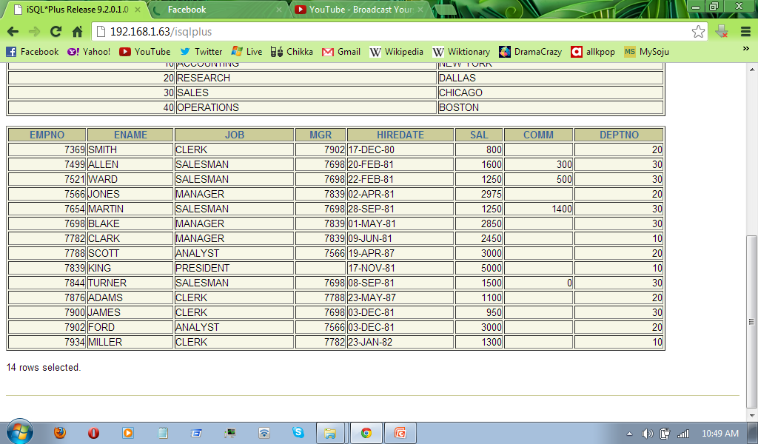
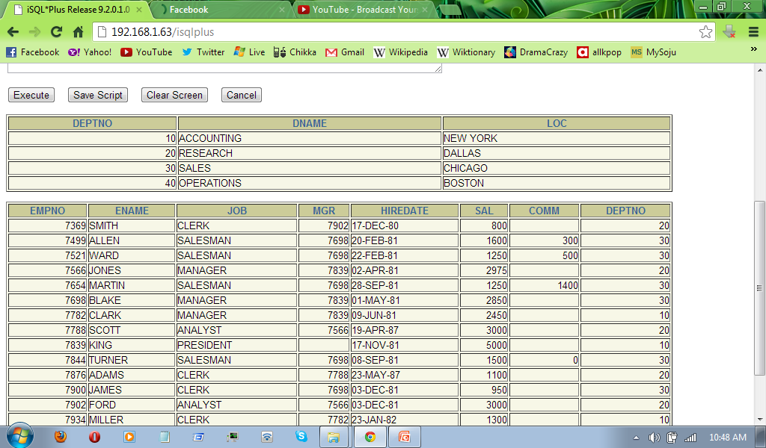
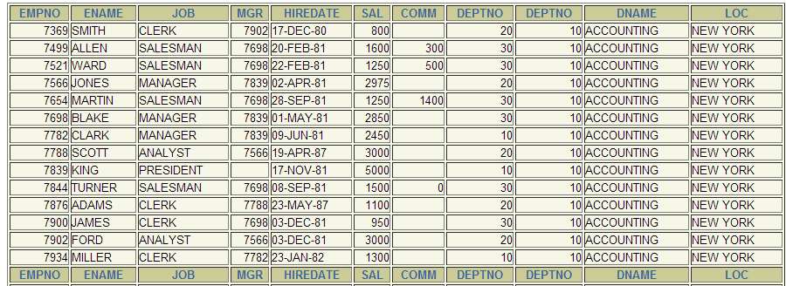
Generating a Cartesian Product
EMPLOYEES (14 rows)
DEPARTMENTS (4 rows)
Cartesian
product:
14x4=56 rows
Notes:
Cartesian Products (continued)
A Cartesian product is generated if a join condition is omitted. The example on the slide displays employee last name and department name from the EMPLOYEES and DEPARTMENTS tables. Because no WHERE clause has been specified, all rows (20 rows) from the EMPLOYEES table are joined with all rows (8 rows) in the DEPARTMENTS table, thereby generating 160 rows in the output.
SELECT last_name, department_name dept_name
FROM employees, departments;
Instructor Note
Demo: 4_cart.sql
Purpose: To illustrate executing a Cartesian product
…

Slide 6
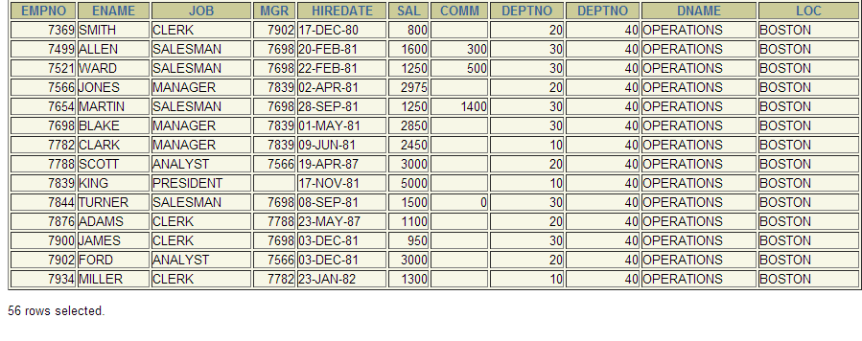
Cartesian Product
SELECT *
FROM emp, dept;
Notes:
Retrieving Records with Equijoins
In the slide example:
The SELECT clause specifies the column names to retrieve:
employee last name, employee number, and department number, which are columns in the EMPLOYEES table
department number, department name, and location ID, which are columns in the DEPARTMENTS table
The FROM clause specifies the two tables that the database must access:
EMPLOYEES table
DEPARTMENTS table
The WHERE clause specifies how the tables are to be joined:
EMPLOYEES.DEPARTMENT_ID = DEPARTMENTS.DEPARTMENT_ID
Because the DEPARTMENT_ID column is common to both tables, it must be prefixed by the table name to avoid ambiguity.

Slide 7
Types of Joins
  Oracle Proprietary
  Joins (8i and prior):
  SQL: 1999
  Compliant Joins:
Equijoin
Non-equijoin
Outer join
Self join
Cross joins
Natural joins
Using clause
Full or two sided outer joins
Arbitrary join conditions for outer joins
Notes:
Types of Joins
The Oracle9i database offers join syntax that is SQL: 1999 compliant. Prior to the 9i release, the join syntax was different from the ANSI standards. The new SQL: 1999 compliant join syntax does not offer any performance benefits over the Oracle proprietary join syntax that existed in prior releases.
Instructor Note
Do not get into details of all the types of joins now. Explain each join one by one, as is done in the following slides.

Slide 8
Joining Tables Using Oracle Syntax
When writing a SELECT statement that joins tables, precede the column name with the table name for clarity and to enhance database access.
If the same column name appears in more than one table, the column name must be prefixed with the table name.
To join n tables together, you need a minimum of n-1 conditions. For example, to join four tables, a minimum of three joins is required.
Notes:
Defining Joins
When data from more than one table in the database is required, a join condition is used. Rows in one table can be joined to rows in another table according to common values existing in corresponding columns, that is, usually primary and foreign key columns.
To display data from two or more related tables, write a simple join condition in the WHERE clause.
In the syntax:
table1.column denotes the table and column from which data is retrieved
table1.column1 = is the condition that joins (or relates) the tables together
table2.column2
Guidelines
When writing a SELECT statement that joins tables, precede the column name with the table name for clarity and to enhance database access.
If the same column name appears in more than one table, the column name must be prefixed with the table name.
To join n tables together, you need a minimum of n-1 join conditions. For example, to join four tables, a minimum of three joins is required. This rule may not apply if your table has a concatenated primary key, in which case more than one column is required to uniquely identify each row.
For more information, see Oracle9i SQL Reference, “SELECT.”

Slide 9
Joining Tables Using Oracle Syntax
Use a join to query data from more than one table.
Write the join condition in the WHERE clause.
Prefix the column name with the table name when the same column name appears in more than one table.
SELECT table1.column, table2.column
FROM table1, table2
WHERE table1.column1 = table2.column2;
Notes:
Defining Joins
When data from more than one table in the database is required, a join condition is used. Rows in one table can be joined to rows in another table according to common values existing in corresponding columns, that is, usually primary and foreign key columns.
To display data from two or more related tables, write a simple join condition in the WHERE clause.
In the syntax:
table1.column denotes the table and column from which data is retrieved
table1.column1 = is the condition that joins (or relates) the tables together
table2.column2
Guidelines
When writing a SELECT statement that joins tables, precede the column name with the table name for clarity and to enhance database access.
If the same column name appears in more than one table, the column name must be prefixed with the table name.
To join n tables together, you need a minimum of n-1 join conditions. For example, to join four tables, a minimum of three joins is required. This rule may not apply if your table has a concatenated primary key, in which case more than one column is required to uniquely identify each row.
For more information, see Oracle9i SQL Reference, “SELECT.”

Slide 10
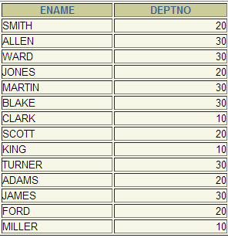
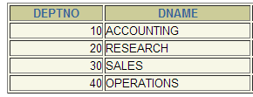
What is an Equijoin?
EMPLOYEES
DEPARTMENTS
Foreign key
Primary key
Notes:
Equijoins
To determine an employee’s department name, you compare the value in the DEPARTMENT_ID column in the EMPLOYEES table with the DEPARTMENT_ID values in the DEPARTMENTS table. The relationship between the EMPLOYEES and DEPARTMENTS tables is an equijoin—that is, values in the DEPARTMENT_ID column on both tables must be equal. Frequently, this type of join involves primary and foreign key complements.
Note: Equijoins are also called simple joins or inner joins.
Instructor Note
Explain the use of a decision matrix for simplifying writing joins. For example, if you want to display the name and department number of all the employees who are in the same department as Goyal, you can start by making the following decision tree:
Columns to Display Originating Table Condition
last_name employees last_name='Goyal'
department_name departments employees.department_id =
departments.department_id
Now the SQL statement can be easily formulated by looking at the decision matrix. The first column gives the column list in the SELECT statement, the second column gives the tables for the FROM clause, and the third column gives the condition for the WHERE clause.

Slide 11
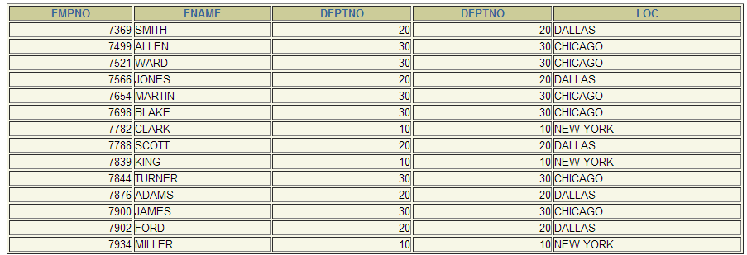
Retrieving Records with Equijoins
SELECT emp.empno, emp.ename,
emp.deptno, dept.deptno,
dept.loc
FROM emp, dept
WHERE emp.deptno = dept.deptno;
Notes:
Retrieving Records with Equijoins
In the slide example:
The SELECT clause specifies the column names to retrieve:
employee last name, employee number, and department number, which are columns in the EMPLOYEES table
department number, department name, and location ID, which are columns in the DEPARTMENTS table
The FROM clause specifies the two tables that the database must access:
EMPLOYEES table
DEPARTMENTS table
The WHERE clause specifies how the tables are to be joined:
EMPLOYEES.DEPARTMENT_ID = DEPARTMENTS.DEPARTMENT_ID
Because the DEPARTMENT_ID column is common to both tables, it must be prefixed by the table name to avoid ambiguity.

Slide 12
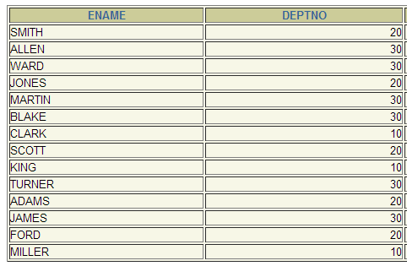
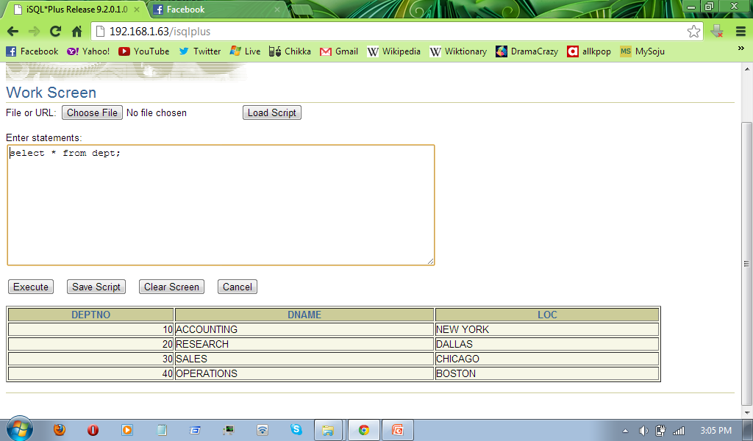
Additional Search Conditions
Using the AND Operator
EMPLOYEES
DEPARTMENTS
Notes:
Additional Search Conditions
In addition to the join, you may have criteria for your WHERE clause to restrict the rows under consideration for one or more tables in the join. For example, to display employee Matos' department number and department name, you need an additional condition in the WHERE clause.
SELECT last_name, employees.department_id,
department_name
FROM employees, departments
WHERE employees.department_id = departments.department_id
AND last_name = 'Matos';

Slide 13
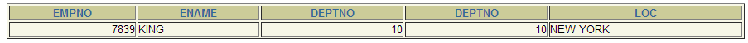
Additional Search Conditions
Using the AND Operator
SELECT emp.empno, emp.ename,
emp.deptno, dept.deptno,
dept.loc
FROM emp, dept
WHERE emp.deptno = dept.deptno
AND ename = ‘KING’;
Notes:
Retrieving Records with Equijoins
In the slide example:
The SELECT clause specifies the column names to retrieve:
employee last name, employee number, and department number, which are columns in the EMPLOYEES table
department number, department name, and location ID, which are columns in the DEPARTMENTS table
The FROM clause specifies the two tables that the database must access:
EMPLOYEES table
DEPARTMENTS table
The WHERE clause specifies how the tables are to be joined:
EMPLOYEES.DEPARTMENT_ID = DEPARTMENTS.DEPARTMENT_ID
Because the DEPARTMENT_ID column is common to both tables, it must be prefixed by the table name to avoid ambiguity.

Slide 14
Qualifying Ambiguous
Column Names
Use table prefixes to qualify column names that are in multiple tables.
Improve performance by using table prefixes.
Distinguish columns that have identical names but reside in different tables by using column aliases.
Notes:
Qualifying Ambiguous Column Names
You need to qualify the names of the columns in the WHERE clause with the table name to avoid ambiguity. Without the table prefixes, the DEPARTMENT_ID column could be from either the DEPARTMENTS table or the EMPLOYEES table. It is necessary to add the table prefix to execute your query.
If there are no common column names between the two tables, there is no need to qualify the columns. However, using the table prefix improves performance, because you tell the Oracle Server exactly where to find the columns.
The requirement to qualify ambiguous column names is also applicable to columns that may be ambiguous in other clauses, such as the SELECT clause or the ORDER BY clause.
Instructor Note
Demo: 4_loc.sql
Purpose: To illustrate a SELECT clause with no aliases.

Slide 15
Qualifying Ambiguous
Column Names
Table Aliases can be up to 30 characters in length, but shorter is better.
If a table alias is used for a particular table name in the FROM clause, then that table alias must be substituted for the table name throughout the SELECT statement.
Table Aliases is valid only for the current SELECT statement.
Notes:
Qualifying Ambiguous Column Names
You need to qualify the names of the columns in the WHERE clause with the table name to avoid ambiguity. Without the table prefixes, the DEPARTMENT_ID column could be from either the DEPARTMENTS table or the EMPLOYEES table. It is necessary to add the table prefix to execute your query.
If there are no common column names between the two tables, there is no need to qualify the columns. However, using the table prefix improves performance, because you tell the Oracle Server exactly where to find the columns.
The requirement to qualify ambiguous column names is also applicable to columns that may be ambiguous in other clauses, such as the SELECT clause or the ORDER BY clause.
Instructor Note
Demo: 4_loc.sql
Purpose: To illustrate a SELECT clause with no aliases.

Slide 16
Using Table Aliases
Simplify queries by using table aliases.
Improve performance by using table prefixes.
SELECT e.empno, e.ename, e.deptno,
d.deptno, d.loc
FROM emp e , dept d
WHERE e.deptno = d.deptno;
Notes:
Table Aliases
Qualifying column names with table names can be very time consuming, particularly if table names are lengthy. You can use table aliases instead of table names. Just as a column alias gives a column another name, a table alias gives a table another name. Table aliases help to keep SQL code smaller, therefore using less memory.
Notice how table aliases are identified in the FROM clause in the example. The table name is specified in full, followed by a space and then the table alias. The EMPLOYEES table has been given an alias of e, and the DEPARTMENTS table has an alias of d.
Guidelines
Table aliases can be up to 30 characters in length, but shorter is better.
If a table alias is used for a particular table name in the FROM clause, then that table alias must be substituted for the table name throughout the SELECT statement.
Table aliases should be meaningful.
The table alias is valid only for the current SELECT statement.

Slide 17
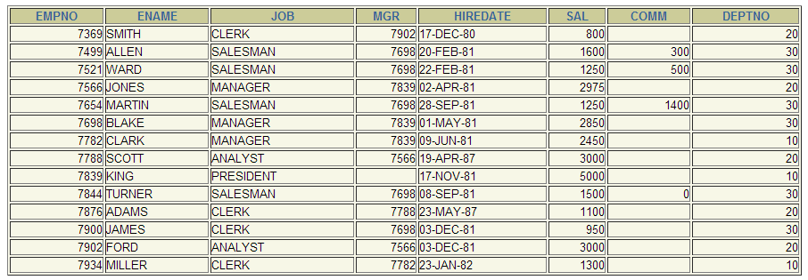
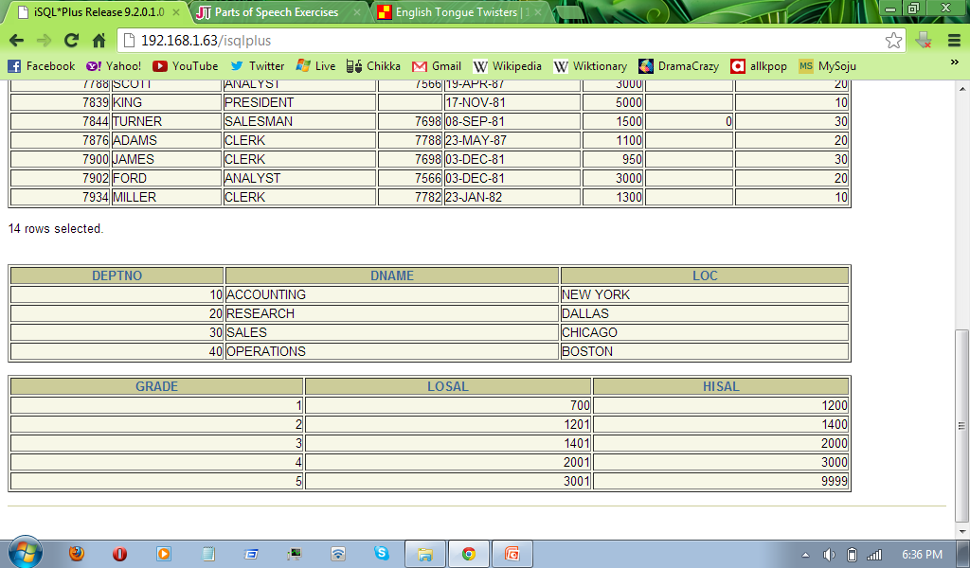
Joining More than Two Tables
EMPLOYEES
DEPARTMENTS
SALARY GRADE
To join n tables together, you need a minimum of n-1 join conditions. For example, to join three tables, a minimum of two joins is required.
Notes:
Additional Search Conditions
Sometimes you may need to join more than two tables. For example, to display the last name, the department name, and the city for each employee, you have to join the EMPLOYEES, DEPARTMENTS, and LOCATIONS tables.
SELECT e.last_name, d.department_name, l.city
FROM employees e, departments d, locations l
WHERE e.department_id = d.department_id
AND d.location_id = l.location_id;
…

Slide 18
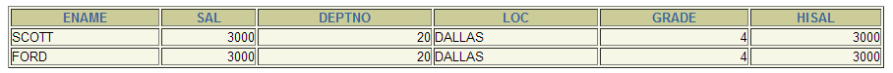
Joining More than Two Tables
SELECT e.ename, e.sal,
d.deptno, d.loc, k.grade, k.hisal
FROM emp e, dept d, salgrade k
WHERE e.deptno = d.deptno
AND e.sal = k.hisal;
Notes:
Non-Equijoins (continued)
The slide example creates a non-equijoin to evaluate an employee’s salary grade. The salary must be between any pair of the low and high salary ranges.
It is important to note that all employees appear exactly once when this query is executed. No employee is repeated in the list. There are two reasons for this:
None of the rows in the job grade table contain grades that overlap. That is, the salary value for an employee can lie only between the low salary and high salary values of one of the rows in the salary grade table.
All of the employees’ salaries lie within the limits provided by the job grade table. That is, no employee earns less than the lowest value contained in the LOWEST_SAL column or more than the highest value contained in the HIGHEST_SAL column.
Note: Other conditions, such as <= and >= can be used, but BETWEEN is the simplest. Remember to specify the low value first and the high value last when using BETWEEN.
Table aliases have been specified in the slide example for performance reasons, not because of possible ambiguity.
Instructor Note
Explain that BETWEEN … AND … is actually translated by the Oracle server to a pair of AND conditions (a >= lower limit) and (a <= higher limit) and IN ( … ) is translated by the Oracle server to a set of OR conditions (a = value1 OR a = value2 OR a = value3 ). So using BETWEEN … AND … , IN(…) has no performance benefits; the benefit is logical simplicity.

Slide 19
Non-Equijoins
EMPLOYEES
JOB_GRADES
Salary in the EMPLOYEES
table must be between
lowest salary and highest
salary in the JOB_GRADES
table.
Notes:
Non-Equijoins
A non-equijoin is a join condition containing something other than an equality operator.
The relationship between the EMPLOYEES table and the JOB_GRADES table has an example of a non-equijoin. A relationship between the two tables is that the SALARY column in the EMPLOYEES table must be between the values in the LOWEST_SALARY and HIGHEST_SALARY columns of the JOB_GRADES table. The relationship is obtained using an operator other than equals (=).

Slide 20
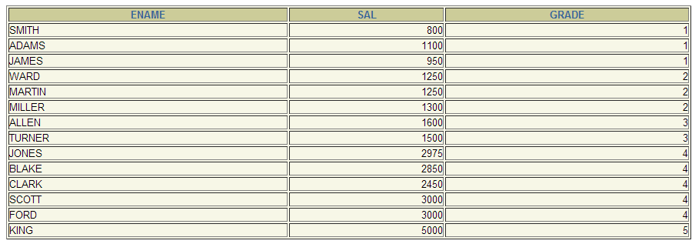
Retrieving Records with Non-Equijoins
SELECT e.ename, e.sal, j.grade
FROM emp e, salgrade j
WHERE e.sal
BETWEEN j.losal AND j.hisal;
Notes:
Non-Equijoins (continued)
The slide example creates a non-equijoin to evaluate an employee’s salary grade. The salary must be between any pair of the low and high salary ranges.
It is important to note that all employees appear exactly once when this query is executed. No employee is repeated in the list. There are two reasons for this:
None of the rows in the job grade table contain grades that overlap. That is, the salary value for an employee can lie only between the low salary and high salary values of one of the rows in the salary grade table.
All of the employees’ salaries lie within the limits provided by the job grade table. That is, no employee earns less than the lowest value contained in the LOWEST_SAL column or more than the highest value contained in the HIGHEST_SAL column.
Note: Other conditions, such as <= and >= can be used, but BETWEEN is the simplest. Remember to specify the low value first and the high value last when using BETWEEN.
Table aliases have been specified in the slide example for performance reasons, not because of possible ambiguity.
Instructor Note
Explain that BETWEEN … AND … is actually translated by the Oracle server to a pair of AND conditions (a >= lower limit) and (a <= higher limit) and IN ( … ) is translated by the Oracle server to a set of OR conditions (a = value1 OR a = value2 OR a = value3 ). So using BETWEEN … AND … , IN(…) has no performance benefits; the benefit is logical simplicity.

Slide 21
Outer Joins
DEPARTMENTS
EMPLOYEES
There are no employees in department 40.
Notes:
Returning Records with No Direct Match with Outer Joins
If a row does not satisfy a join condition, the row will not appear in the query result. For example, in the equijoin condition of EMPLOYEES and DEPARTMENTS tables, employee Grant does not appear because there is no department ID recorded for her in the EMPLOYEES table. Instead of seeing 20 employees in the result set, you see 19 records.
SELECT e.last_name, e.department_id, d.department_name
FROM employees e, departments d
WHERE e.department_id = d.department_id;
…

Slide 22
Outer Joins Syntax
You use an outer join to also see rows that do not meet the join condition.
The Outer join operator is the plus sign (+).
SELECT table1.column, table2.column
FROM table1, table2
WHERE table1.column(+) = table2.column;
SELECT table1.column, table2.column
FROM table1, table2
WHERE table1.column = table2.column(+);
Notes:
Using Outer Joins to Return Records with No Direct Match
The missing rows can be returned if an outer join operator is used in the join condition. The operator is a plus sign enclosed in parentheses (+), and it is placed on the “side” of the join that is deficient in information. This operator has the effect of creating one or more null rows, to which one or more rows from the nondeficient table can be joined.
In the syntax:
table1.column = is the condition that joins (or relates) the tables together.
table2.column (+) is the outer join symbol, which can be placed on either side of the
WHERE clause condition, but not on both sides. (Place the outer
join symbol following the name of the column in the table without the matching rows.)
Instructor Note
Demo: 4_ejoin.sql
Purpose: To illustrate an equijoin leading to an outer join.

Slide 23
Outer Joins Syntax
The outer join operator can appear only on one side of the expression – the side that has information missing. It returns those rows from one table that have no direct match in the other table.
A condition involving an outer join cannot use the IN operator or be linked to another condition by the OR operator.
Notes:
Using Outer Joins to Return Records with No Direct Match
The missing rows can be returned if an outer join operator is used in the join condition. The operator is a plus sign enclosed in parentheses (+), and it is placed on the “side” of the join that is deficient in information. This operator has the effect of creating one or more null rows, to which one or more rows from the nondeficient table can be joined.
In the syntax:
table1.column = is the condition that joins (or relates) the tables together.
table2.column (+) is the outer join symbol, which can be placed on either side of the
WHERE clause condition, but not on both sides. (Place the outer
join symbol following the name of the column in the table without the matching rows.)
Instructor Note
Demo: 4_ejoin.sql
Purpose: To illustrate an equijoin leading to an outer join.

Slide 24
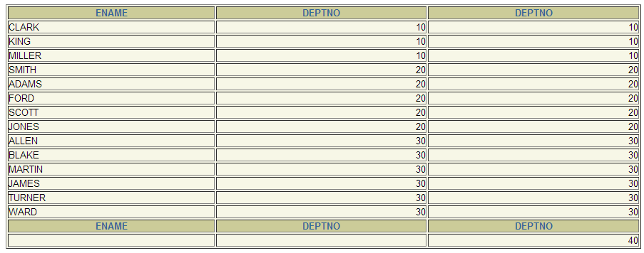
Using Outer Joins
SELECT e.ename, e.deptno, d.deptno
FROM emp e, dept d
WHERE e.deptno(+) = d.deptno;
Notes:
Using Outer Joins to Return Records with No Direct Match (continued)
The slide example displays employee last names, department ID’s and department names. The Contracting department does not have any employees. The empty value is shown in the output shown.
Outer Join Restrictions
The outer join operator can appear on only one side of the expression—the side that has information missing. It returns those rows from one table that have no direct match in the other table.
A condition involving an outer join cannot use the IN operator or be linked to another condition by the OR operator.
Instructor Note
The UNION operator works around the issue of being able to use an outer join operator on one side of the expression. The ANSI full outer join also allows you to have an outer join on both sides of the expression. It is discussed later in this lesson.
Demo: 4_ojoin.sql
Purpose: To illustrate an outer join.

Slide 25
Self Joins
EMPLOYEES (WORKER)
EMPLOYEES (MANAGER)
MGR in the WORKER table is equal to EMPNO in the MANAGER table.
Notes:
Joining a Table to Itself
Sometimes you need to join a table to itself. To find the name of each employee’s manager, you need to join the EMPLOYEES table to itself, or perform a self join. For example, to find the name of Whalen’s manager, you need to:
Find Whalen in the EMPLOYEES table by looking at the LAST_NAME column.
Find the manager number for Whalen by looking at the MANAGER_ID column. Whalen’s manager number is 101.
Find the name of the manager with EMPLOYEE_ID 101 by looking at the LAST_NAME column. Kochhar’s employee number is 101, so Kochhar is Whalen’s manager.
In this process, you look in the table twice. The first time you look in the table to find Whalen in the LAST_NAME column and MANAGER_ID value of 101. The second time you look in the EMPLOYEE_ID column to find 101 and the LAST_NAME column to find Kochhar.
Instructor Note
Show the data from the EMPLOYEES table and point out how each manager is also an employee.

Slide 26
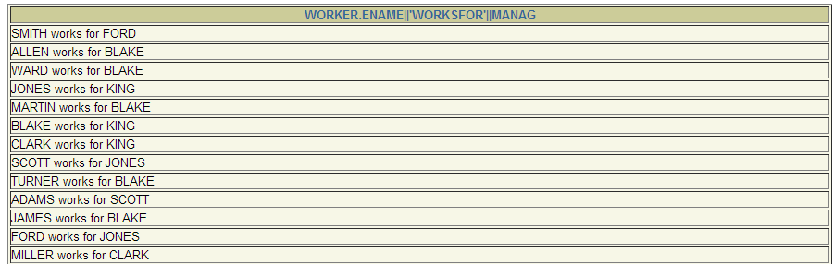
Joining a Table to Itself
SELECT worker.ename || ' works for '
|| manager.ename
FROM emp worker, emp manager
WHERE worker.mgr = manager.empno;
Notes:
Joining a Table to Itself (continued)
The slide example joins the EMPLOYEES table to itself. To simulate two tables in the FROM clause, there are two aliases, namely w and m, for the same table, EMPLOYEES.
In this example, the WHERE clause contains the join that means “where a worker’s manager number matches the employee number for the manager.”
Instructor Note
Point out the following to the students:
The column heading in the result of the query on the slide seems meaningless. A meaningful column alias should have been used instead.
There are only 19 rows in the output, but there are 20 rows in the EMPLOYEES table. This occurs because employee King, who is the president, does not have a manager.

Slide 27
Creating Cross Joins
The CROSS JOIN clause produces the cross-product of two tables.
This is the same as a Cartesian product between the two tables.
SELECT ename, dname
FROM emp
CROSS JOIN dept;
Notes:
Creating Cross Joins
The example on the slide gives the same results as the following:
SELECT last_name, department_name
FROM employees, departments;
…

Slide 28
Creating Natural Joins
The NATURAL JOIN clause is based on all columns in the two tables that have the same name.
It selects rows from the two tables that have equal values in all matched columns.
If the columns having the same names have different data types, an error is returned.
Notes:
Creating Natural Joins
It was not possible to do a join without explicitly specifying the columns in the corresponding tables in prior releases of Oracle. In Oracle9i it is possible to let the join be completed automatically based on columns in the two tables which have matching data types and names, using the keywords NATURAL JOIN keywords.
Note: The join can happen only on columns having the same names and data types in both the tables. If the columns have the same name, but different data types, then the NATURAL JOIN syntax causes an error.

Slide 29
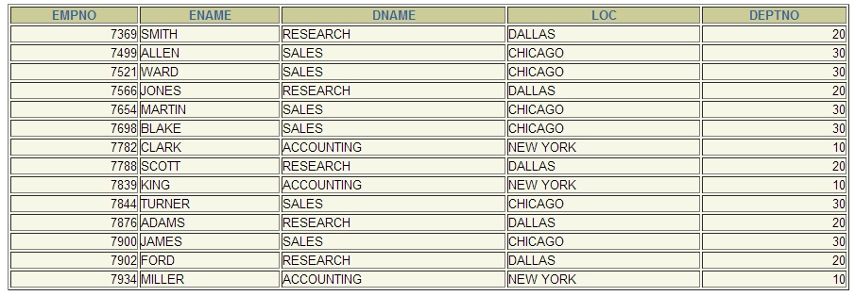
Retrieving Records with Natural Joins
SELECT empno, ename, dname, loc, deptno
FROM emp
NATURAL JOIN dept;
Notes:
Retrieving Records with Natural Joins
In the example on the slide, the LOCATIONS table is joined to the DEPARTMENT table by the LOCATION_ID column, which is the only column of the same name in both tables. If other common columns were present, the join would have used them all.
Equijoins
The natural join can also be written as an equijoin:
SELECT department_id, department_name,
departments.location_id, city
FROM departments, locations
WHERE departments.location_id = locations.location_id;
Natural Joins with a WHERE Clause
Additional restrictions on a natural join are implemented by using a WHERE clause. The example below limits the rows of output to those with a department ID equal to 20 or 50.
SELECT department_id, department_name,
location_id, city
FROM departments
NATURAL JOIN locations
WHERE department_id IN (20, 50);

Slide 30
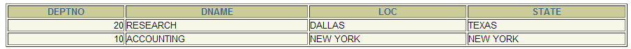
Retrieving Records with Natural Joins
SELECT deptno, dname, loc, state
FROM dept
NATURAL JOIN location
WHERE deptno IN(10,20);
Notes:
Retrieving Records with Natural Joins
In the example on the slide, the LOCATIONS table is joined to the DEPARTMENT table by the LOCATION_ID column, which is the only column of the same name in both tables. If other common columns were present, the join would have used them all.
Equijoins
The natural join can also be written as an equijoin:
SELECT department_id, department_name,
departments.location_id, city
FROM departments, locations
WHERE departments.location_id = locations.location_id;
Natural Joins with a WHERE Clause
Additional restrictions on a natural join are implemented by using a WHERE clause. The example below limits the rows of output to those with a department ID equal to 20 or 50.
SELECT department_id, department_name,
location_id, city
FROM departments
NATURAL JOIN locations
WHERE department_id IN (20, 50);

Slide 31
Creating Joins with the USING Clause
If several columns have the same names but the data types do not match, the NATURAL JOIN clause can be modified with the USING clause to specify the columns that should be used for an equijoin.
Use the USING clause to match only one column when more than one column matches.
Do not use a table name or alias in the referenced columns.
The NATURAL JOIN and USING clauses are mutually exclusive.
Notes:
The USING Clause
Natural joins use all columns with matching names and data types to join the tables. The USING clause can be used to specify only those columns that should be used for an equijoin. The columns referenced in the USING clause should not have a qualifier (table name or alias) anywhere in the SQL statement.
For example, this statement is valid:
SELECT l.city, d.department_name
FROM locations l JOIN departments d USING (location_id)
WHERE location_id = 1400;
This statement is invalid because the LOCATION_ID is qualified in the WHERE clause:
SELECT l.city, d.department_name
FROM locations l JOIN departments d USING (location_id)
WHERE d.location_id = 1400;
ORA-25154: column part of USING clause cannot have qualifier
The same restriction applies to NATURAL joins also. Therefore columns that have the same name in both tables have to be used without any qualifiers.

Slide 32
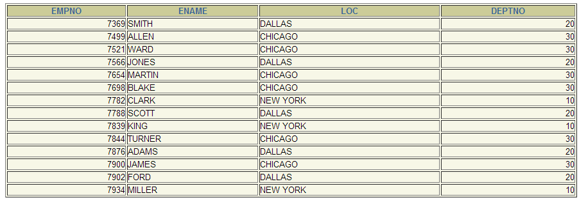
Retrieving Records with the USING Clause
SELECT e.empno, e.ename, d.loc, deptno
FROM emp e JOIN dept d
USING (deptno) ;
Notes:
The USING Clause (continued)
The example shown joins the DEPARTMENT_ID column in the EMPLOYEES and DEPARTMENTS tables, and thus shows the location where an employee works.
This can also be written as an equijoin:
SELECT employee_id, last_name,
employees.department_id, location_id
FROM employees, departments
WHERE employees.department_id = departments.department_id;

Slide 33
Creating Joins with the ON Clause
The join condition for the natural join is basically an equijoin of all columns with the same name.
To specify arbitrary conditions or specify columns to join, the ON clause is used.
The join condition is separated from other search conditions.
The ON clause makes code easy to understand.
Notes:
The ON Condition
Use the ON clause to specify a join condition. This lets you specify join conditions separate from any search or filter conditions in the WHERE clause.

Slide 34
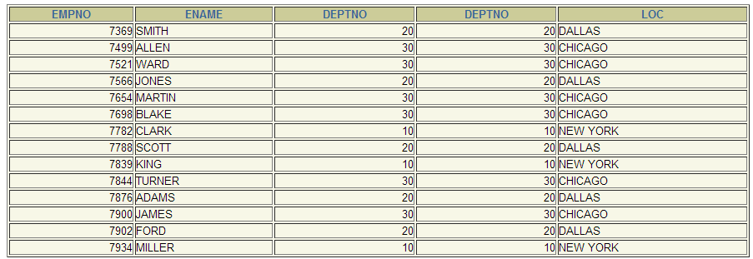
Retrieving Records with the ON Clause
SELECT e.empno, e.ename, e.deptno,
d.deptno, d.loc
FROM emp e JOIN dept d
ON (e.deptno = d.deptno);
Notes:
Creating Joins with the ON Clause
The ON clause can also be used as follows to join columns that have different names:
SELECT e.last_name emp, m.last_name mgr
FROM employees e JOIN employees m
ON (e.manager_id = m.employee_id);
The preceding example is a selfjoin of the EMPLOYEE table to itself, based on the EMPLOYEE_ID and MANAGER_ID columns.
…

Slide 35
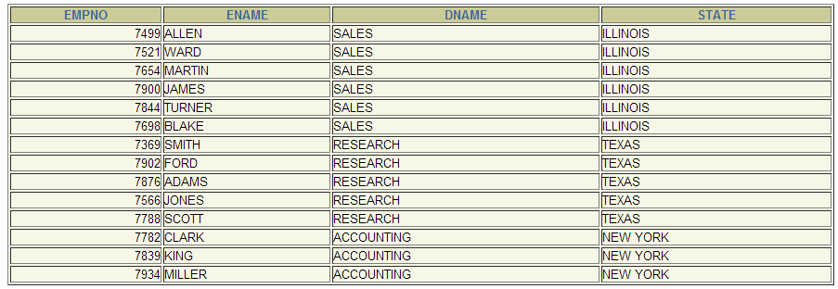
Creating Three-Way Joins with the ON Clause
SELECT empno, ename, dname, state
FROM emp e
JOIN dept d
ON d.deptno = e.deptno
JOIN location l
ON d.loc = l.loc;
Notes:
Three-Way Joins
A three-way join is a join of three tables. In SQL: 1999 compliant syntax, joins are performed from left to right so the first join to be performed is EMPLOYEES JOIN DEPARTMENTS. The first join condition can reference columns in EMPLOYEES and DEPARTMENTS but cannot reference columns in LOCATIONS. The second join condition can reference columns from all three tables.
This can also be written as a three-way equijoin:
SELECT employee_id, city, department_name
FROM employees, departments, locations
WHERE employees.department_id = departments.department_id
AND departments.location_id = locations.location_id;
Instructor Note
The example shown can also be accomplished with the USING clause:
SELECT e.employee_id, l.city, d.department_name
FROM employees e
JOIN departments d
USING (department_id)
JOIN locations l
USING (location_id);

Slide 36
INNER Versus OUTER Joins
In SQL: 1999, the join of two tables returning only matched rows is an inner join.
A join between two tables that returns the results of the inner join as well as unmatched rows left (or right) tables is a left (or right) outer join.
A join between two tables that returns the results of an inner join as well as the results of a left and right join is a full outer join.
Notes:
Joins - Comparing SQL: 1999 to Oracle Syntax

Slide 37
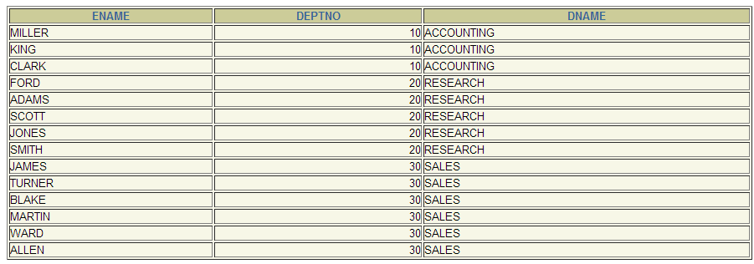
LEFT OUTER JOIN
SELECT e.ename, e.deptno, d.dname
FROM emp e
LEFT OUTER JOIN dept d
ON (e.deptno = d.deptno) ;
Notes:
Example of LEFT OUTER JOIN
This query retrieves all rows in the EMPLOYEES table, which is the left table even if there is no match in the DEPARTMENTS table.
This query was completed in earlier releases as follows:
SELECT e.last_name, e.department_id, d.department_name
FROM employees e, departments d
WHERE d.department_id (+) = e.department_id;

Slide 38
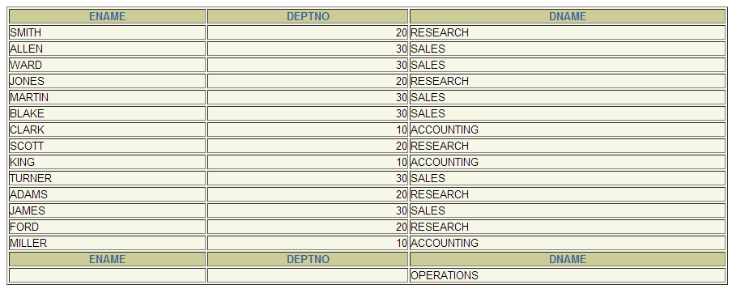
RIGHT OUTER JOIN
SELECT e.ename, e.deptno, d.dname
FROM emp e
RIGHT OUTER JOIN dept d
ON (e.deptno = d.deptno) ;
Notes:
Example of RIGHT OUTER JOIN
This query retrieves all rows in the DEPARTMENTS table, which is the right table even if there is no match in the EMPLOYEES table.
This query was completed in earlier releases as follows:
SELECT e.last_name, e.department_id, d.department_name
FROM employees e, departments d
WHERE d.department_id = e.department_id (+);

Slide 39
FULL OUTER JOIN
SELECT e.ename, e.deptno, d.dname
FROM emp e
FULL OUTER JOIN dept d
ON (e.deptno = d.deptno) ;
Notes:
Example of FULL OUTER JOIN
This query retrieves all rows in the EMPLOYEES table, even if there is no match in the DEPARTMENTS table. It also retrieves all rows in the DEPARTMENTS table, even if there is no match in the EMPLOYEES table.
Instructor Note
It was not possible to complete this in earlier releases using outer joins. However, you could accomplish the same results using the UNION operator.
SELECT e.last_name, e.department_id, d.department_name
FROM employees e, departments d
WHERE e.department_id (+) = d.department_id
UNION
SELECT e.last_name, e.department_id, d.department_name
FROM employees e, departments d
WHERE e.department_id = d.department_id (+);

Slide 40
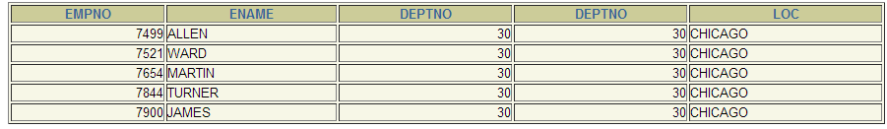
Additional Conditions
SELECT e.empno, e.ename, e.deptno,
d.deptno, d.loc
FROM emp e JOIN dept d
ON (e.deptno = d.deptno)
AND e.mgr = 7698 ;
Notes:
Applying Additional Conditions
You can apply additional conditions in the WHERE clause. The example shown performs a join on the EMPLOYEES and DEPARTMENTS tables, and, in addition, displays only employees with a manager ID equal to 149.

Slide 41
Summary
In this lesson, you should have learned how to use
joins to display data from multiple tables in:
Oracle proprietary syntax for versions 8i and earlier
SQL: 1999 compliant syntax for version 9i
Notes:
Summary
There are multiple ways to join tables.
Types of Joins
Equijoins
Non-equijoins
Outer joins
Self joins
Cross joins
Natural joins
Full or outer joins
Cartesian Products
A Cartesian product results in all combinations of rows displayed. This is done by either omitting the WHERE clause or specifying the CROSS JOIN clause.
Table Aliases
Table aliases speed up database access.
Table aliases can help to keep SQL code smaller, by conserving memory.

Slide 42
Practice 4, Part Two: Overview
This practice covers the following topics:
Joining tables using an equijoin
Performing outer and self joins
Adding conditions
Notes:
Practice 4, Part Two
This practice is intended to give you practical experience in extracting data from more than one table. Try using both the Oracle proprietary syntax and the SQL: 1999 compliant syntax.
In Part Two, questions 5-8, try writing the join statements using ANSI syntax.
In Part Two, questions 9-11, try writing the join statements using both the Oracle syntax and the ANSI syntax.

